Slide 1
Affection of Java Design Patterns
to Cohesion Metrics
ZYKOV Sergey
ALEXANDROV Dmitry
ISMOILOV Maqsudjon
KOZLOV Artem
SAVACHENKO Anton
Moscow, 2021

Slide 2
Introduction. Cohesion metrics
Utilizing class cohesion metrics can promote Java code static analysis quality, improve object-oriented programming practices and suggest advanced and efficient ones.
jPeek is software tool for measuring cohesion in Java classes.
LCOM LCOM2 LCOM3 LCOM4 LCOM5 CCM CAMC | MMAC NHD PCC LCC SCOM TCC OCC

Slide 3
Introduction. Design Patterns
Adapter Builder Bridge Chain of Responsibilities Command Composite Decorator | Factory method Iterator Mediator Memento Observer Prototype

Slide 4
Introduction. Theory
Do Java design patterns affect to cohesion metrics?

Slide 5
Experimental Process
Were designed from 3 to 5 simple programs for each pattern.
Almost all projects return zero values.
Reason: simplicity of the programs.

Slide 6
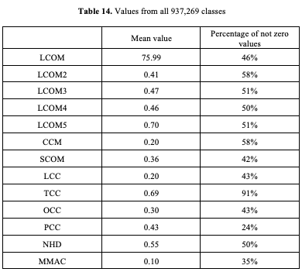
Experimental Process
Was collected 33,006 open source projects from the Maven repository.
After filtering, there are 24,926 projects left with a total number of classes equal to 937,269.
Snippets of the results we obtained for the different patterns are shown in table.

Slide 7
Experimental Process. Analysis
Pattern classes were selected from all classes.
Mean result of each pattern was compared to overall results and made correlation analysis between input data (i.e. methods and attributes) and output data (i.e. results).
Composite pattern has common trend of getting lower results, however, two metrics gave us more obvious deviations.

Slide 8
LCOM4
LCOM4 gave the negative result that was not expected to get because the lower bound of LCOM4 is zero. We suppose that jPeek has a technical error counting LCOM4 results. In addition, it is not clear how jPeek normalizes LCOM4 metric, because normalization from 0 to 1 is not comparable with its formula. This is the reason why LCOM4 is excluded from the further review.

Slide 9
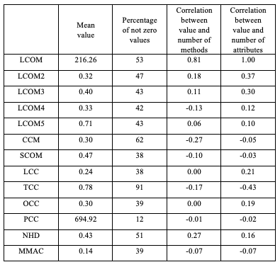
Memento
The memento pattern has a large number of attributes. We assume that this feature was the reason for the better results of LCOM2-LCOM3, LCOM5, SCOM, OCC, and PCC, whose formulas are based on common attributes.

Slide 10
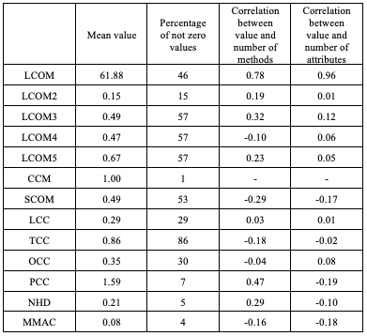
Chain of responsibility
The issue of the chain of responsibility pattern is that there is a small number of attributes that are being shared during the work of this pattern.

Slide 11
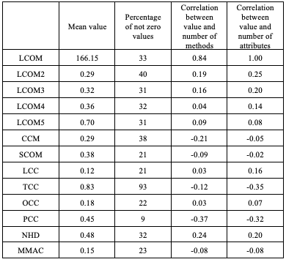
Factory
A factory often consists of methods used to create an instance of a class without having many attributes, so it has fewer non-zero values

Slide 12
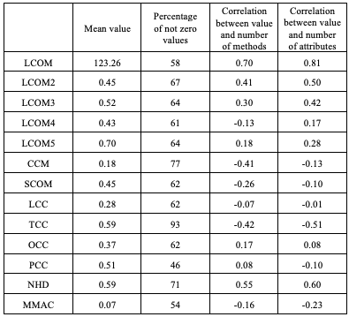
Builder
On the contrary, builder pattern has less nonzero values and almost the same values and it tells us that builders usually play a role of setters and constructors for other classes.

Slide 13
Rest of metrics
Prototype, command, memento and bridge patterns show controversial result. In some metrics, they have better results and in other metrics worse. And all this without any consistent pattern. For clear conclusion, there should be more detailed research for these patterns. Finally, the rest of metrics does not have any differences in results compared to overall results.

Slide 14
Conclusion
The results that are described above raise a question about the usability potential of jPeek. A large number of metrics give zero or NaN values in approximately a half of cases, which makes it difficult to use for average users who have projects with a small number of classes.
Overall, our experiments show us that metrics work better on big projects with many numbers of methods and attributes in classes comparing with small projects, but we cannot say that jPeek is able to estimate both kids of projects properly.

Slide 15
Further goals
The goal of our next step is to make a comprehensive analysis of jPeek with analogous plugins to make it clear if it is the issue of jPeek or the issue of class cohesion metrics.
During the provided experiments, we discovered several inconsistencies between theoretical description of metrics and its jPeek realization, so these possible incorrectnesses should be fixed for confident of correct data in the samples.

Slide 16
References
jPeek (2021) [Source code]. https://github.com/cqfn/jpeek.
S. R. Chidamber and C. F. Kemerer. Towards a metrics suite for object oriented design. In: ACM, 1991, vol. 26, no. 11.
S.R.Chidamber, and C.F.Kemerer. A Metrics Suite for Object Oriented Design. In: IEEE Transactions on Software Engineering, 1994, 20(6), pp. 476-493.
W.Li, and S.M.Henry. Maintenance metrics for the object oriented paradigm. In: Proc. 1st International Software Metrics Symposium, Baltimore, MD: IEEE Computer Society, 1993. pp. 52-60.
M.Hitz, and B.Montazeri. Chidamber & Kemerer's metrics suite: a measurement theory perspective. In: IEEE Transactions on Software Engineering, 1996, 22(4), pp. 267-271.
B.Henderson-Sellers. Object-Oriented Metrics: Measures of Complexity. In: New Jersey, PrenticeHall, 1996, pp. 142-147.
J.Bansiya, L.Etzkorn, C.Davis, and W.Li. A Class Cohesion Metric For Object-Oriented Designs. In: JOOP, 1999, 11(8), pp. 47-52.
H. Aman, K. Yamasaki, H. Yamada, and M.-T. Noda. A proposal of class cohesion metrics using sizes of cohesive parts. In: Proc. of Fifth Joint Conference on Knowledge-based Software Engineering, 2002, pp. 102–107.
J. Al Dallal. A design-based cohesion metric for object-oriented classes. In: International Journal of Computer Science and Engineering, 2007, Vol. 1, No. 3, pp. 195-200.
S. Counsell, S. Swift, and J. Crampton. The interpretation and utility of three cohesion metrics for object-oriented design. In: ACM Transactions on Software Engineering and Methodology (TOSEM), vol. 15, no. 2, pp. 123–149, 2006.
M. Wasiq. Measuring Class Cohesion in Object-Oriented Systems. In: Master Thesis at the King Fahd University of Petroleum & Minerals, 2001.
L. Fernandez and R. Pen˜a. A sensitive metric of class cohesion. In: International Journal "Information Theories & Applications" vol. 13, pp. 82–91, 2006.
J. M. Bieman and B.-K. Kang. Cohesion and reuse in an object-oriented system. In: ACM SIGSOFT Software Engineering Notes, vol. 20, no. SI. ACM, 1995, pp. 259–262.
J. Al Dallal. Transitive-based object-oriented lack-of-cohesion metric. In: Procedia computer science, vol. 3, pp. 1581–1587, 2011.
A. Marcus and D. Poshyvanyk. The conceptual cohesion of classes. In: 21st IEEE International Conference on Software Maintenance (ICSM’05). IEEE, 2005, pp. 133–142.
Y. Liu, D. Poshyvanyk, R. Ferenc, T. Gyimothy, and N. Chrisochoides. Modeling class cohesion as mixtures of latent topics. In: Software Maintenance, 2009. ICSM 2009. IEEE International Conference on. IEEE, 2009, pp. 233–242.
L. Etzkorn and H. Delugach. Towards a semantic metrics suite for object-oriented design. In: Technology of Object-Oriented Languages and Systems, 2000. TOOLS 34. Proceedings. 34th International Conference on. IEEE, 2000, pp. 71–80.
Gamma, Erich; Helm, Richard; Johnson, Ralph; Vlissides, John (1995). Design Patterns: Elements of Reusable Object-Oriented Software. Addison-Wesley. ISBN 978-0-201-63361-0.

Slide 17



Thank you for your attention!
Grant YBN2020065057
“Static Analysis of Object Cohesion to Increase Java Code Quality”

